Slide 1

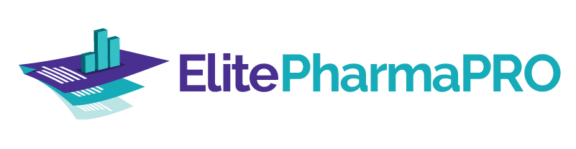
Single cloud-based platform for pharmacies to enable optimization of inventory, ordering, track & trace, and analytics.

Slide 2
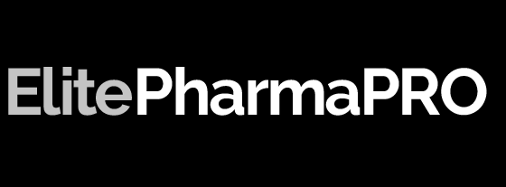
Agenda
Optimized Drug Purchasing
Electronically Integrated Wholesalers
Our aim is to help our customers maximize profits and give insights on the real-time information & with minimal user-interaction, make it easy for the users to manage day-to-day ordering, inventory and compliance throughout the pharmacy network
DSCSA Track and Trace Compliance
Inventory Management
Drug Reconciliation
Reporting Platform

Slide 3


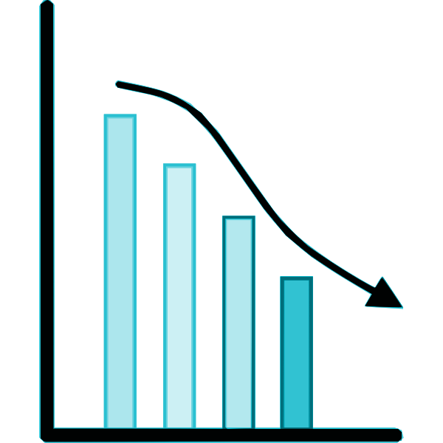
Optimized Drug Purchasing
How conventional ordering works
Prepare a list of drugs to order
On an average, a pharmacy takes around 1.5 - 2 hours daily to order drugs, if not more.
Select cheapest among all to order
Check pricing on each individual wholesaler website
This turns out to be the operational cost of above $1500 per month.
Elite PharmaPRO aims to reduce this operational cost
Check each alternative pricing on individual wholesaler
Identify alternatives
info@elitepharmapro.com | 929-MYELITE

Slide 4

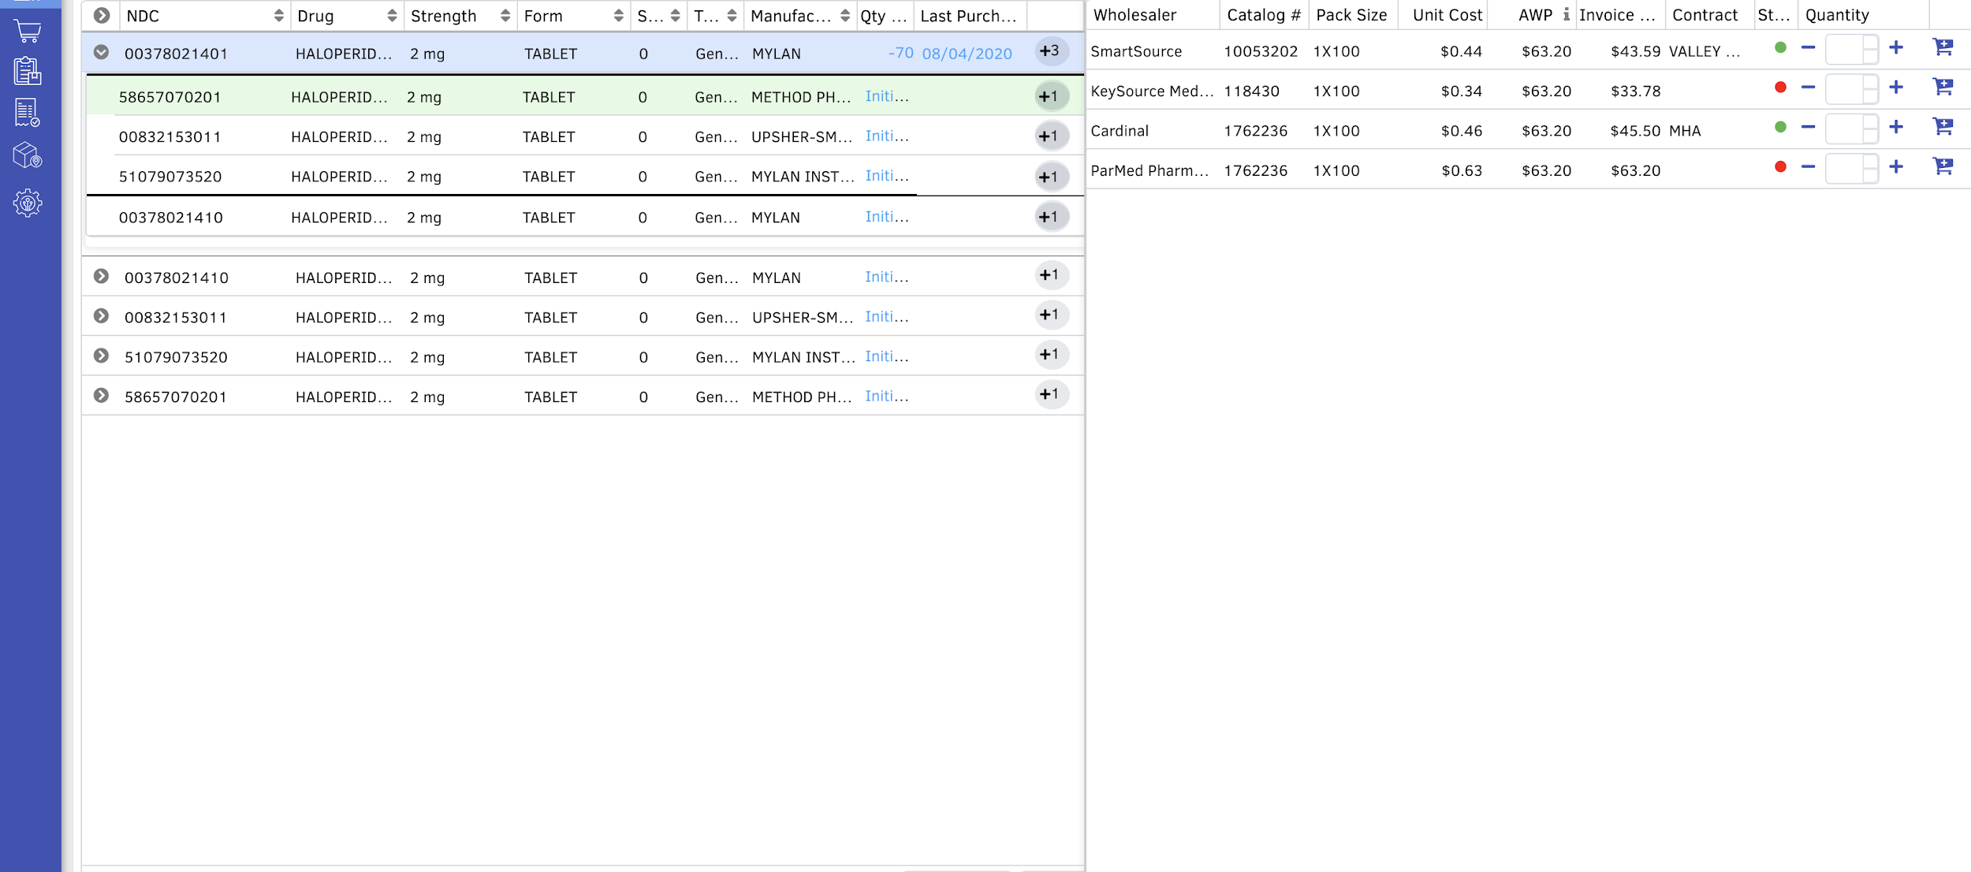

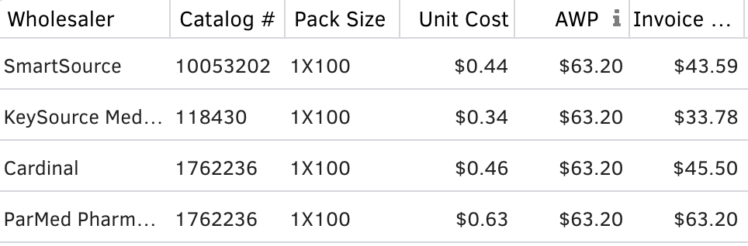
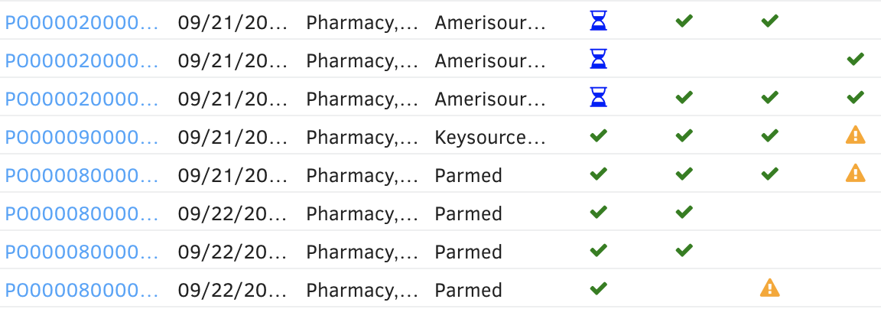
Optimized Drug Purchasing
With Elite PharmaPRO, you can finish drug ordering in as minimal as 15 minutes
Compare the price of drugs and their alternatives from all of your contracted wholesaler in a single place.
Track the status of your purchase order
View your purchase invoices from all contracted wholesaler in a single place
info@elitepharmapro.com | 929-MYELITE

Slide 5




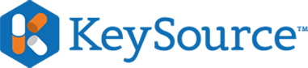




Some of our electronically integrated wholesalers
We will integrate with any wholesalers that may not be currently integrated with us.
(If wholesaler is not ready to integrate, you can still upload their price file & compare the pricing with other wholesalers)
info@elitepharmapro.com | 929-MYELITE

Slide 6

DSCSA Track and Trace Compliance
Our drug serialization track and trace solution is developed by strictly following the DSCSA guidelines.
Stay compliant with drug serialization requirements as per DSCSA guidelines and support your compliance efforts with a comprehensive repository of shipment information
Records of
Transaction History
Transaction Information
Transaction Statement
Easy access to all historical data

Slide 7
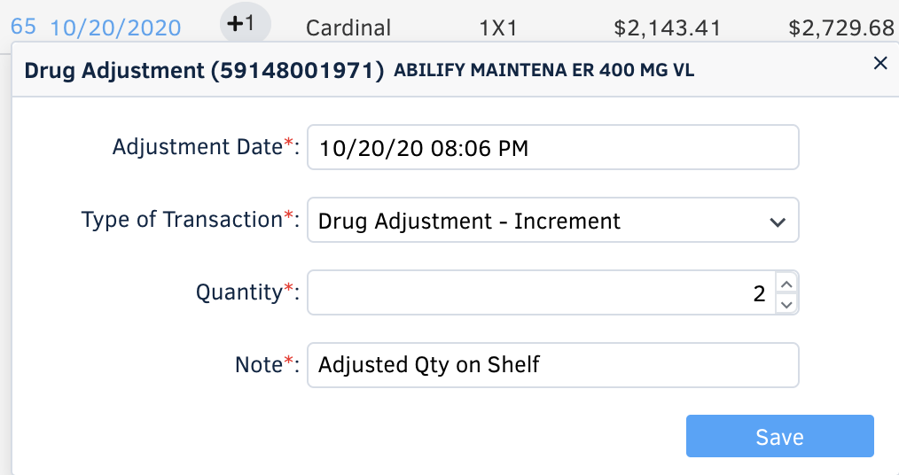
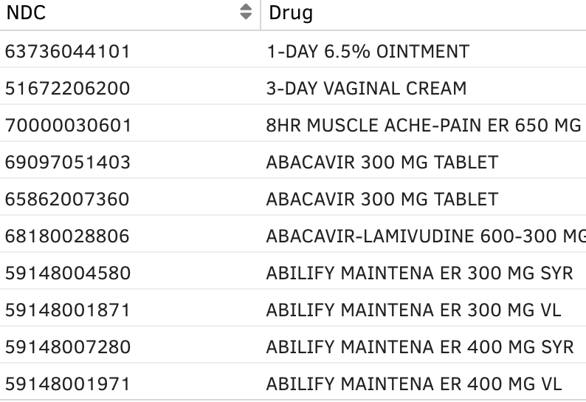
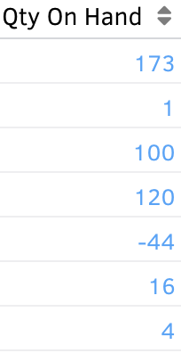
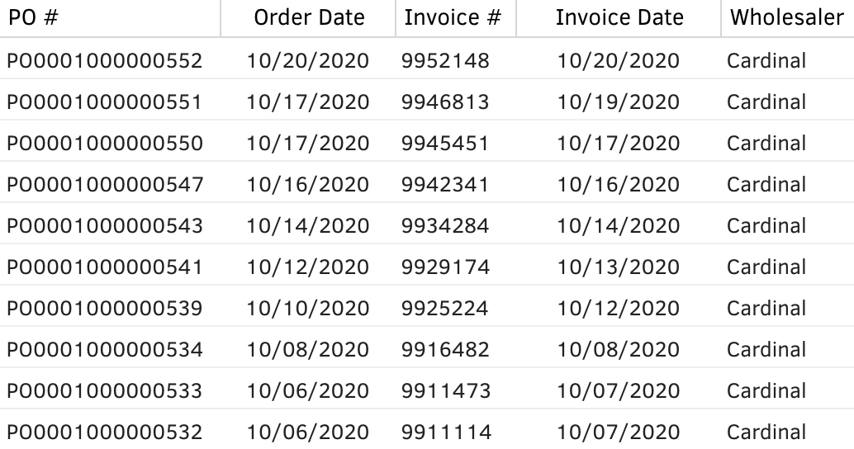
Inventory Management
Take control of your most valuable asset with Elite PharmaPRO’s inventory management tool that integrates with your Pharmacy Software to help you maintain and audit inventory.
Complete Tracking
Perpetual Visibility
Know precise amount of each medication, including pills, liquids, refrigerated and shelved materials
Know the precise value of your inventory at any given time
Cash Flow
Optimized Inventory
Capitalize on increased cash flow to fund other important investment
Eliminate duplicate or obsolete inventory and reduce drug waste, drive maximum inventory turns

Slide 8




Inventory Management
EDI Integration
Auto Reorder
Customization
Reports
Elite PharmaPRO keeps the inventory up-to-date by automatically receiving and updating the purchase & dispense data from your contracted wholesalers and pharmacy software. It requires little to no user interaction to keep inventory updated.
Pharmacies can set a reorder level for each medication or Elite PharmaPRO will recommend medications for ordering based on usage data.
The application is designed to be highly configurable. This allows you to set up the application to follow your best practices so that you can manage your business as you see fit
Multiple in-built reports can give you insights about your day to day inventory as well as help you prepare for your annual inventory audit to avoid discrepancies
info@elitepharmapro.com | 929-MYELITE

Slide 9
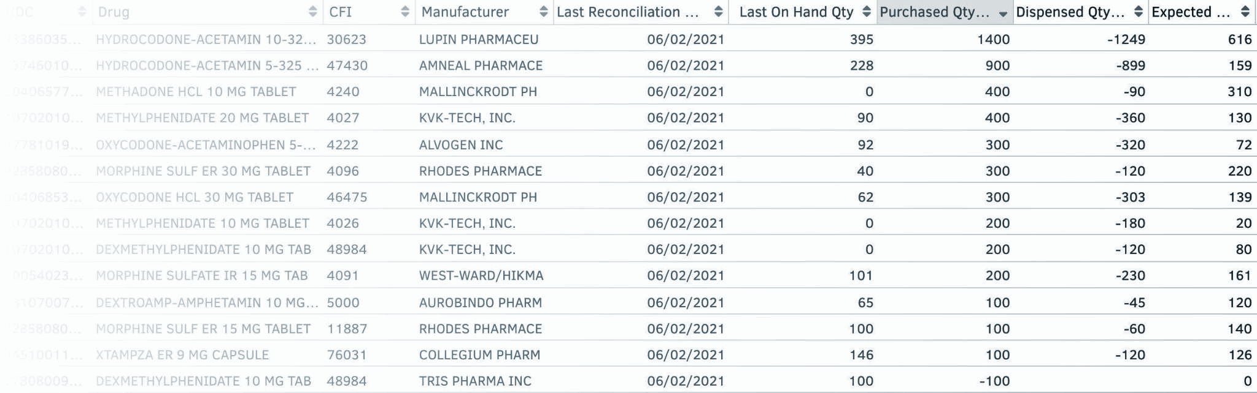
Drug Reconciliation
Last Reconciliation Count
Purchased
Qty
Dispensed
Qty
Current Expected Qty on Hand
Processed automatically from
Wholesaler invoices &
Pharmacy dispense data
Built-in drug reconciliation tool keeps you audit-ready for controlled substances. Elite PharmaPRO automatically counts the expected quantity on hand based on the last reconciliation count and makes it easy for you to report the discrepancies.
info@elitepharmapro.com | 929-MYELITE

Slide 10

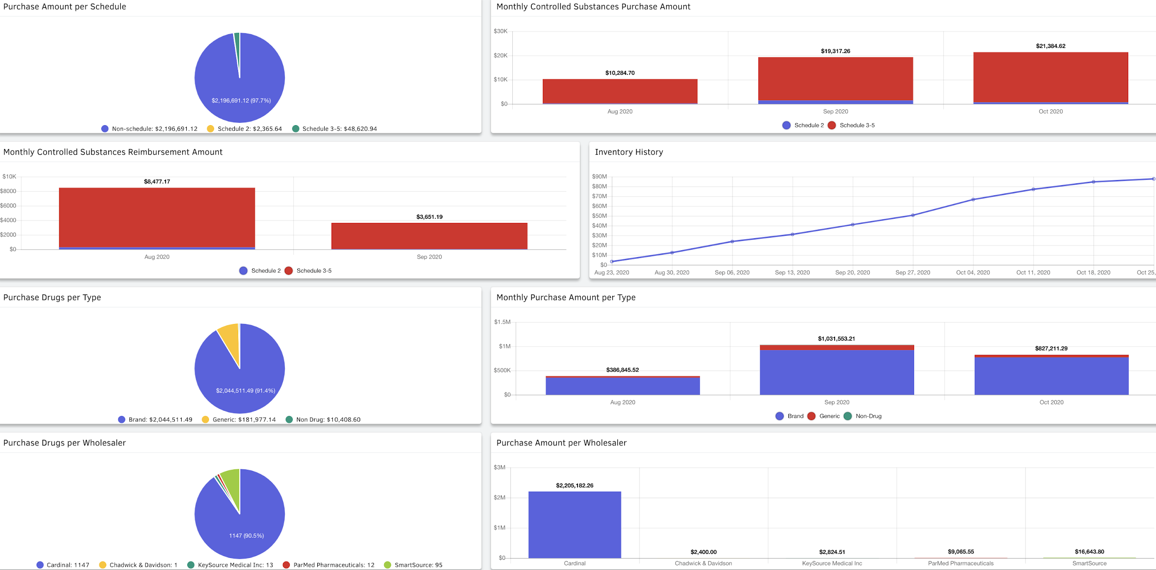

Elite PharmaPRO’s Reporting Platform
Interactive Dashboards, Downloads, Exports & More
Track performance against established organizational goals (KPI’s)
Easily Filter Dashboards for Your Needs
User-Friendly and Interactive Platform
Make Actionable, Data-Driven Decisions
Access and Share Information with Key Stakeholders

Slide 11
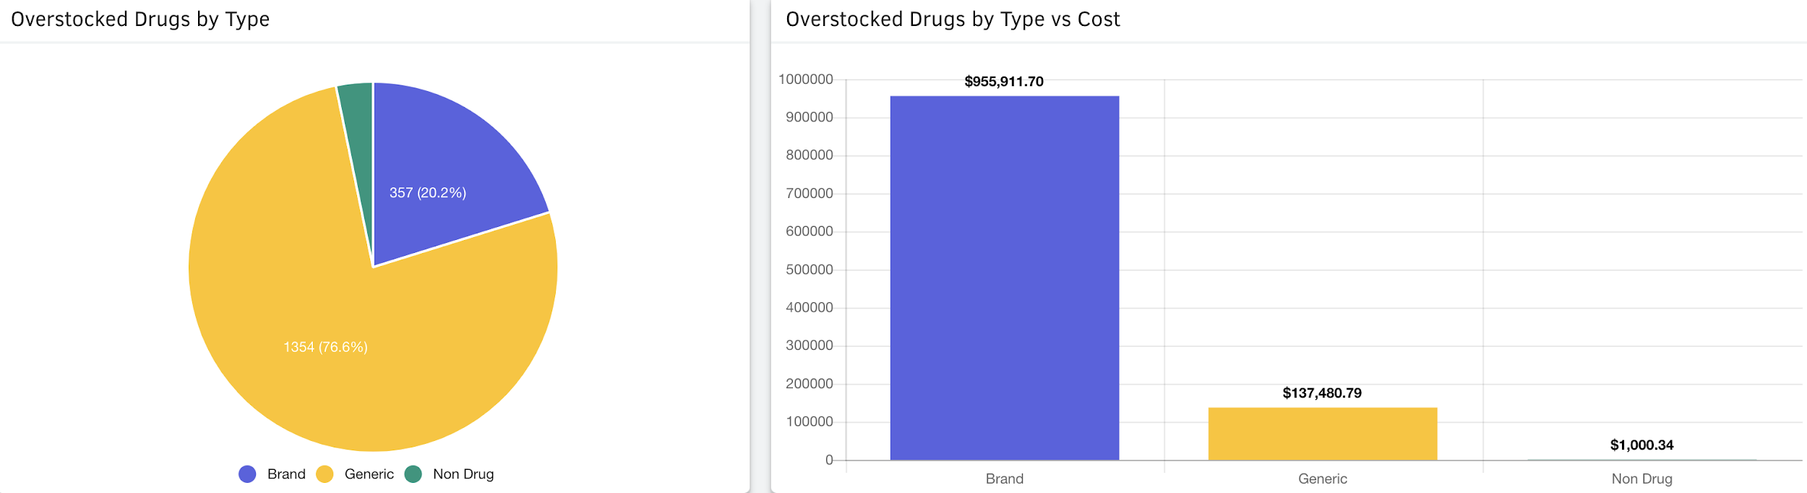

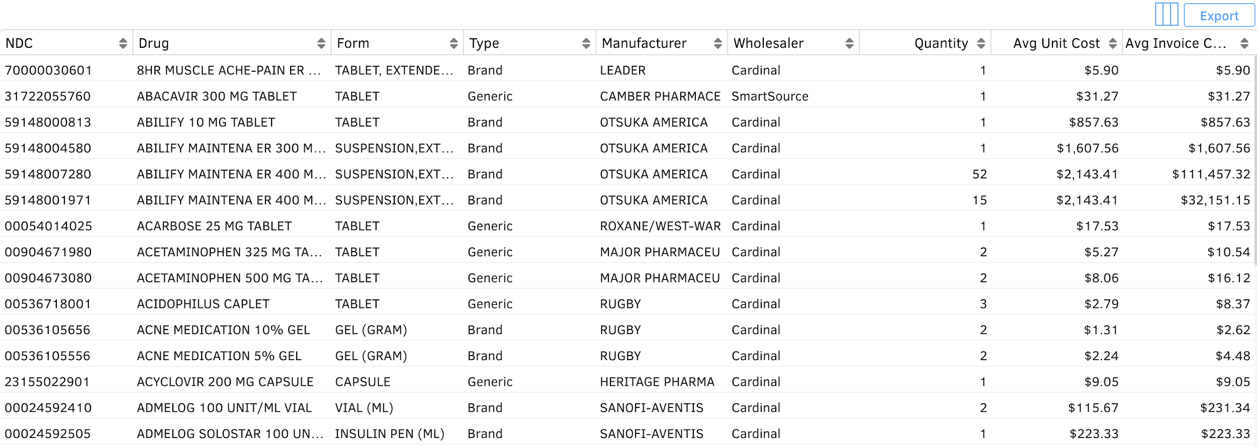


The Right Data, At the Right Time
Real-Time Dashboards
Real-time dashboards allow management to make intelligent decisions to improve pharmacy operations.
Custom Reports
Elite PharmaPRO team can design custom, ad hoc reports upon request to meet the needs of any organization.
Data Exports
Elite PharmaPRO has a vast catalog of reports & data that can be downloaded or exported at any given time.
info@elitepharmapro.com | 929-MYELITE

